Slide 1
5.1-5.4 Advanced Security
Miscellaneous Security Settings
Only for the cool advanced kids
brought to you by clem, ceo of subway

Slide 2
System
Run: “control system” or Win+Pause|Break
System info
Edition
Processor
RAM
Network info
Computer name
Domain/workgroup

Slide 3
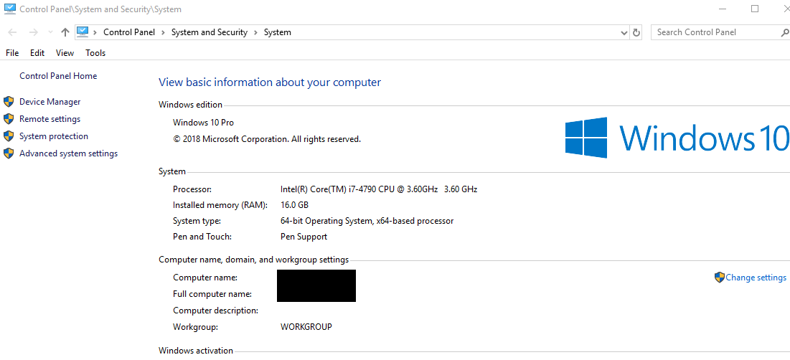
SYSTEM
Clicking on any of these will take you to ...

Slide 4
5.1 System Properties

Slide 5
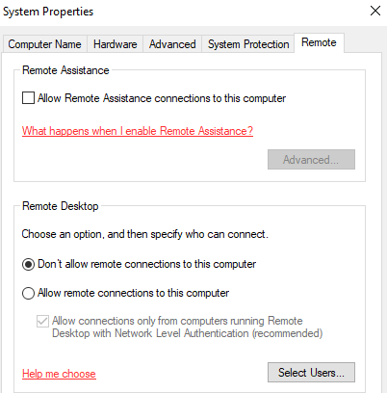
System Properties
There are more tabs than “Remote”

Slide 6
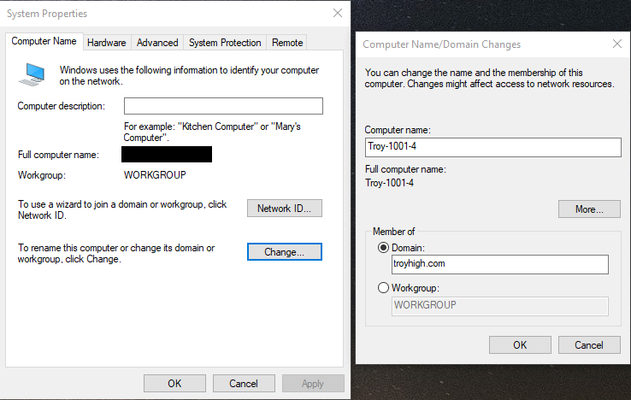
Computer Name
Change description
Change network ID
Joining workgroup/domain
Change computer name/domain

Slide 7
Computer Groups
Homegroup - network of computers in a home
Workgroup - network of computers in a workplace
Domain - network of computers in a corporation
Homegroups and workgroups are decentralized
No central computer handling all the users and computers etc

Slide 8
Why Rename?
Organization
Instead of “Please fix DESKTOP-DNM5QRM”
“Please fix Troy-1001-4”
as in “the 4th computer in room 1001 at Troy”

Slide 9
Why Rename? (cont.)
Quick access in a private network
WIN-5LATHCLO73A.contoso.com
vs
mail.contoso.com
DNS does make this easier without needing to rename your computers, however (will talk about later)

Slide 10
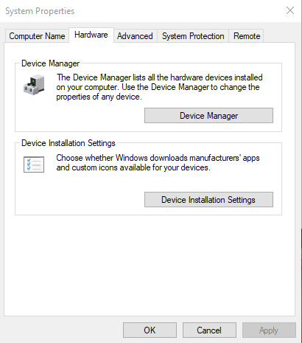
Hardware
Access the device manager
Change settings for driver updates
More for tech support than security

Slide 11
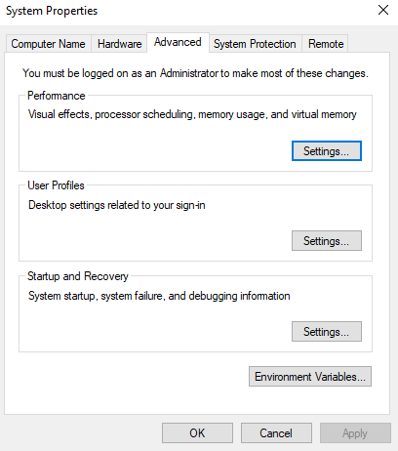
Advanced
Change performance
Handle user profiles
Startup settings
Environment variables (useful for commands and others)

Slide 12
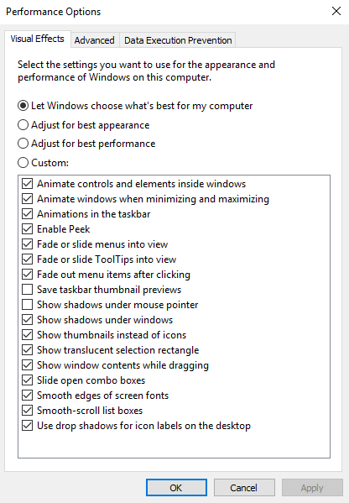
Performance Options
Make your VM go “i am speed”
Adjust for best performance if you wish
kerchoo

Slide 13
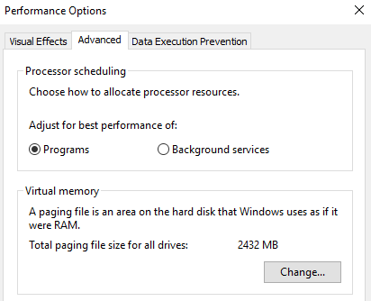
Perf - Adv
Remember LSP’s “Clear virtual memory at shutdown”?
Here it is again

Slide 14
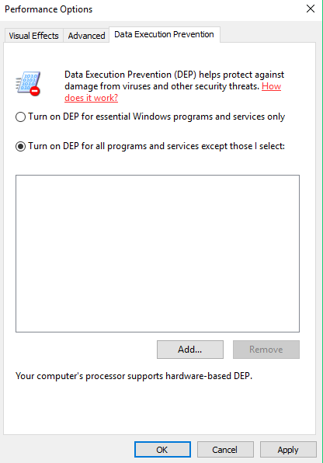
DEP
Performs additional checks on memory to prevent malicious code from running
Should turn on for ALL

Slide 15
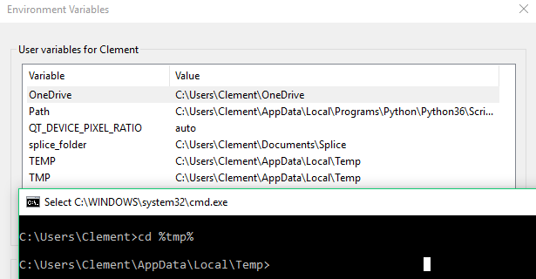
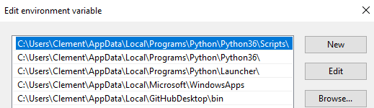
Env vars
Path is a special variable:
Specifies directories to look for executables
Take a look at Path above

Slide 16
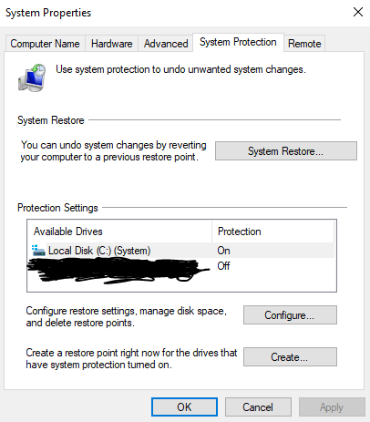
System Protection
Set up restore point in case of failure
Important in the real world

Slide 17
Remote
You can also modify which users can Remote Desktop
As a review, best security practices are?
No remote assistance
Remote Desktop disabled

Slide 18
5.2 System Configuration Utility

Slide 19
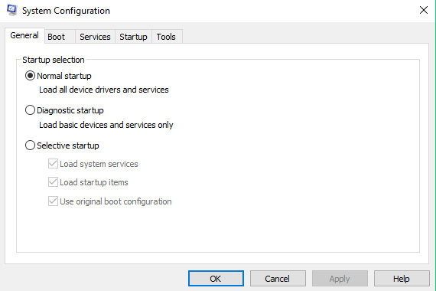
System Conf. Utility
Run: “msconfig”
For startup configuration

Slide 20
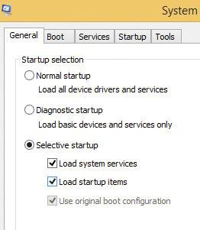
General
Choose specific startup type
Normal
Diagnostic
Only basic drivers and services start
Selective
Choose what loads
Good for startup troubleshooting

Slide 21
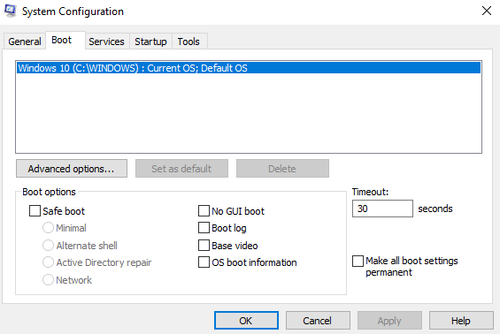
Boot
Control/modify Windows boot environment
Safe boot includes many options
Only really useful for boot troubleshooting

Slide 22
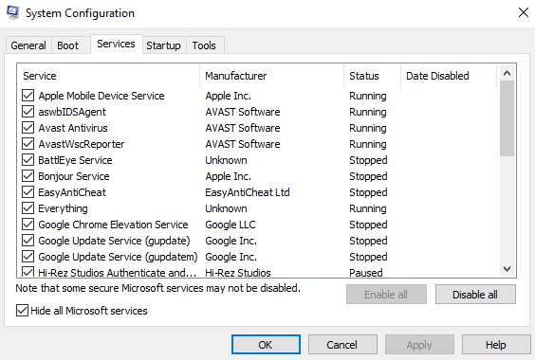
Services
Select which services are started at boot
Most useful thing is “Hide all Microsoft services”
Shows you custom services

Slide 23


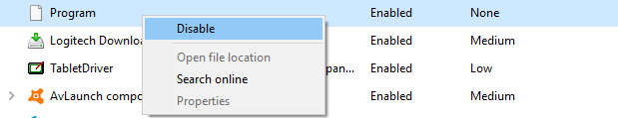
Startup
Redirects you to Task Manager
Make sure nothing bad is running at startup

Slide 24
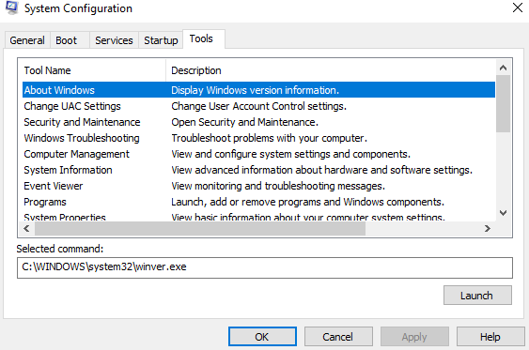
Tools
Quick access to many different tools available from Windows
Not much new here, just a center point for many tools you’ve seen before

Slide 25
5.3 Monitoring Tools

Slide 26
Monitoring
Important in realizing on-off or repeated suspicious activity
Really helpful when being attacked by hackers

Slide 27
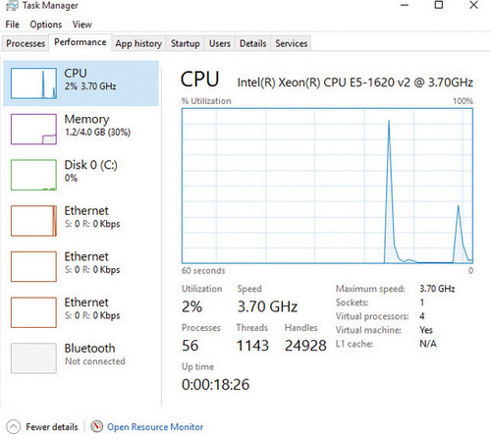
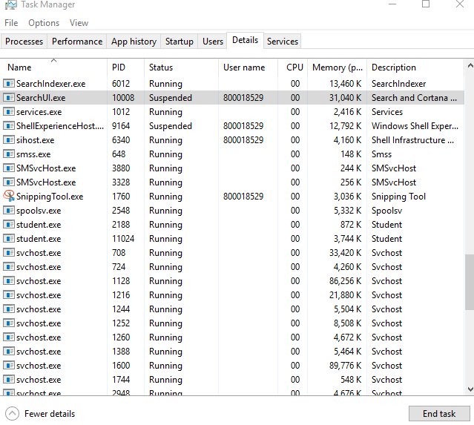
Task Manager
Quick access by right-clicking taskbar
Performance spikes can be indicative of something
Details tab shows process names

Slide 28
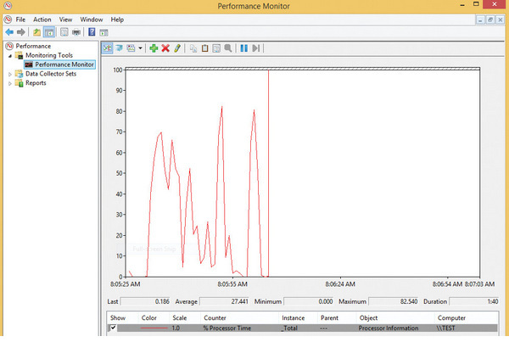
Performance Monitor
Good for specific measurements
Counter - specific measurement for objects
Counters exist for cache, memory, paging file, disk, etc.

Slide 29
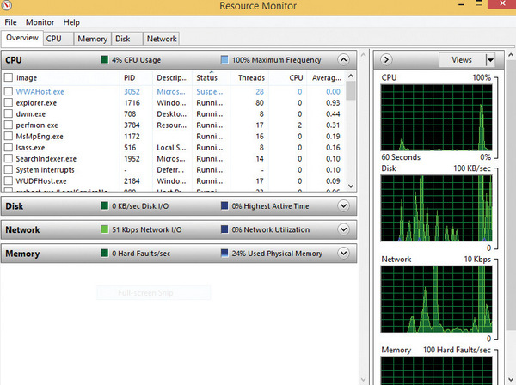
Resource Monitor
Like task manager, but splits between CPU, Disk, Network, and Memory for each process

Slide 30
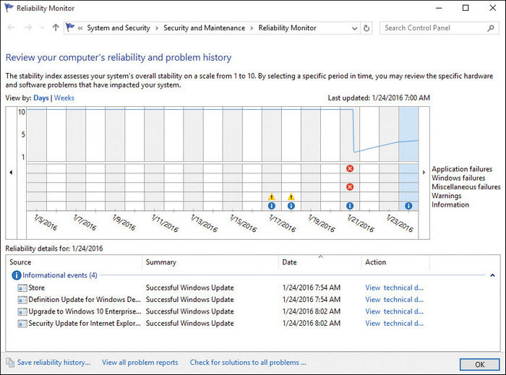
Reliability Monitor
Most useful for servers or other critical computers that need to provide reliable service
Quickly view critical reliability issues like failed updates, crashes, etc.

Slide 31
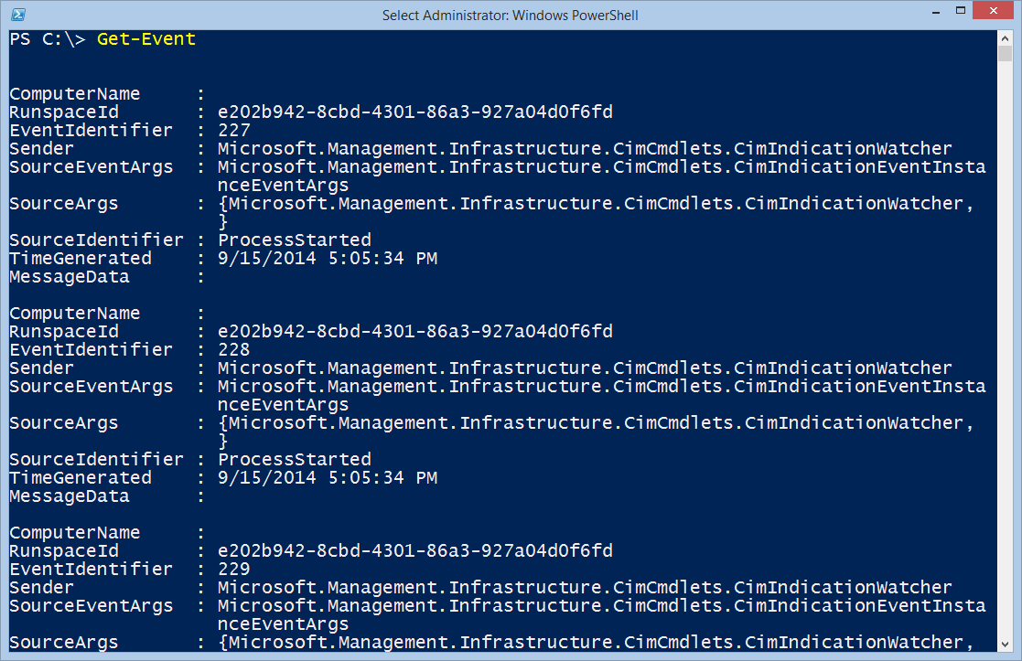
Customized monitoring via terminal
Use customized batch/powershell script
Can customize to show only new processes, processes in Windows dir, etc.

Slide 32
Summary of Monitors
Task Manager
Performance Monitor
Resource Monitor
Reliability Monitor
Customized Terminal Monitor
Task Manager and Customized Terminal Monitor are arguably the best to use in cybersecurity
Others are more for tech stats/support

Slide 33
5.4 Windows Registry

Slide 34
Registry
The complicated heart of all Windows software and hardware
Include:
Port configurations
App preferences
User profiles
Specific conf for each user
Loaded into RAM during boot, updates continuously

Slide 35
Reg Terminology
regedit - tool to edit registry
hive - branch of registry for organization
key - like a folder, contains values
value - registry setting
data - the state of a setting
type - the type of the data
can be SZ for string, BINARY, DWORD, MULTI_SZ, QWORD

Slide 36
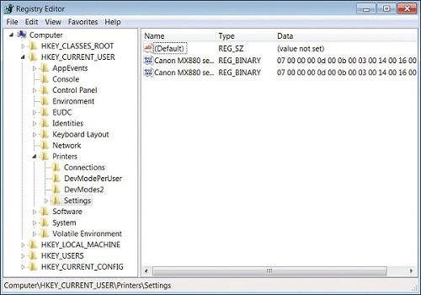

Slide 37
Five subtrees
All hives begin with HKEY

Slide 38
Registry subtree | Subtree function
HKEY_CLASSES_ROOT | Holds file associations and file links Allows the correct application to start when you double-click a filename
HKEY_CURRENT_USER | User configuration, such as software settings, desktop appearance, user-created folders
HKEY_LOCAL_MACHINE | Global hardware configuration List of hardware components with their software drivers Settings for each device
HKEY_USERS | User preferences
HKEY_CURRENT_CONFIG | Hardware profile info used on boot

Slide 39
Where is GPEDIT?
GPEDIT settings are split into
Computer Configuration
User Configuration
Corresponding subtrees are:
LOCAL_MACHINE
CURRENT_USER

Slide 40
Making changes
Relatively simple
Search for registry value
If value doesn’t exist, create a new one
Set the data
It’s a good idea to backup before changing something you don’t know
File > Export
Saves as a .reg file

Slide 41
Why bother with registry?
Sometimes malicious settings are set in critical areas that wouldn’t normally be found with GPEDIT or other tools
Typically registry searching is saved for last, as it is the most obscure

Slide 42
END of Part I
Any questions?

